Slide 1

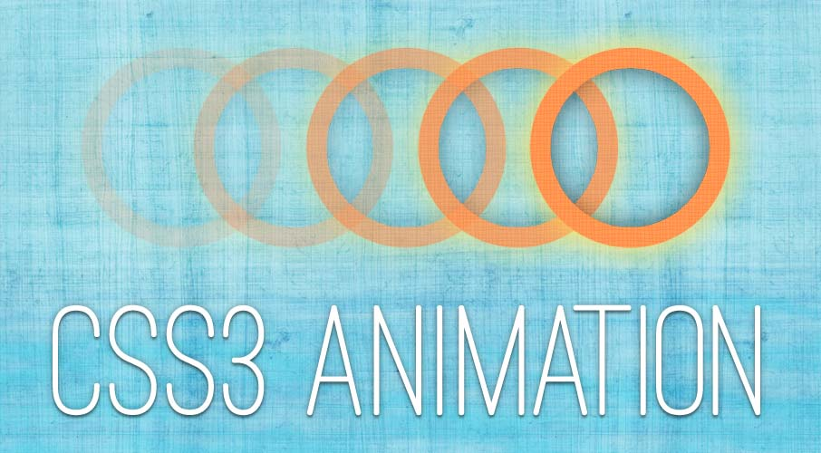

CSS Transitions and Animations
Animated HTML Elements
Svetlin Nakov
Technical Trainer
www.nakov.com
Software University
http://softuni.bg

Slide 2

Table of Contents
CSS Transitions
delay, duration, property, timing-function
Sugar syntaxes
CSS Animation
delay, direction, duration, full-mode
Iteration-count, name, play-state, timing-function

Slide 3
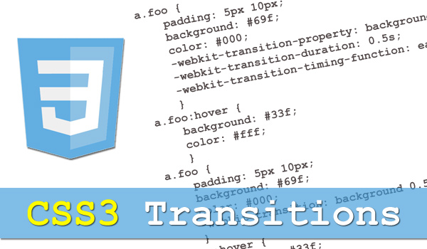
CSS Transitions

Slide 4



CSS Transitions
Transition: changing from one style to another, without using Flash animations or script
Work on 10.0+, 26.0+(4.0 -webkit-), 16.0+(4.0 -moz-)
delay: when transition effect will start (in seconds)
duration: how many time to complete (seconds or milliseconds)
property: which CSS property name transition effect is for
timing-function: speed curve of the transition effect
linear: same speed from start to the end
ease: (default) slow start, fast middle, then end slowly

Slide 5
CSS Transition – Example
Long syntax:
Short syntax:
.transition-only-width {
width: 100px;
transition-property: width;
transition-delay: 500ms;
transition-duration: 2s;
transition-timing-function: linear;
}
.transition-only-width: hover {
width: 400px;
}
.transition-only-width {
width:100px;
transition: width linear 2s;
}
.transition-only-width:hover {
width:400px;
}

Slide 6
Transition: Multiple Changes
We can initialize more than one property in one transition
.transition-only-width {
width: 100px;
height: 100px;
background-color: tomato;
transition: width linear 2s, height 2s, background-color 2s;
}
.transition-only-width:hover {
width: 400px;
height: 400px;
background-color: pink !important;
}

Slide 7
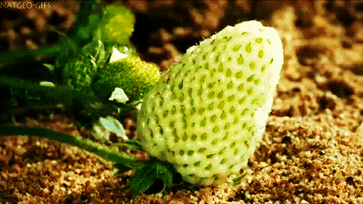
CSS Transitions
Live Demo

Slide 8

Animation

Slide 9
CSS Animation: @keyframe
@keyframe
Initializes a named “variable” which defines animation lifecycle
@keyframe changing-background {
0% {background: red;} 25% {background: yellow;} 50% {background: blue;} 100% {background: green;}
}
@keyframe red-to-yellow {
from {background: red;} to {background: yellow;}
}

Slide 10



Animation
Animation: create animations which can replace Flash animations, animated images, and JavaScripts in existing web pages.
Support: 10.0+, 26.0+ (4.0-webkit-), 16.0 (5.0 -moz-)
delay: when animation will start
direction: play in reverse on alternate cycles or opposite
fill-mode: styles apply for tags when the animation is not playing
iteration-count: replay animations
name: name of the @keyframes animation
play-state: running or paused
timing-function: speed curve of the animation

Slide 11
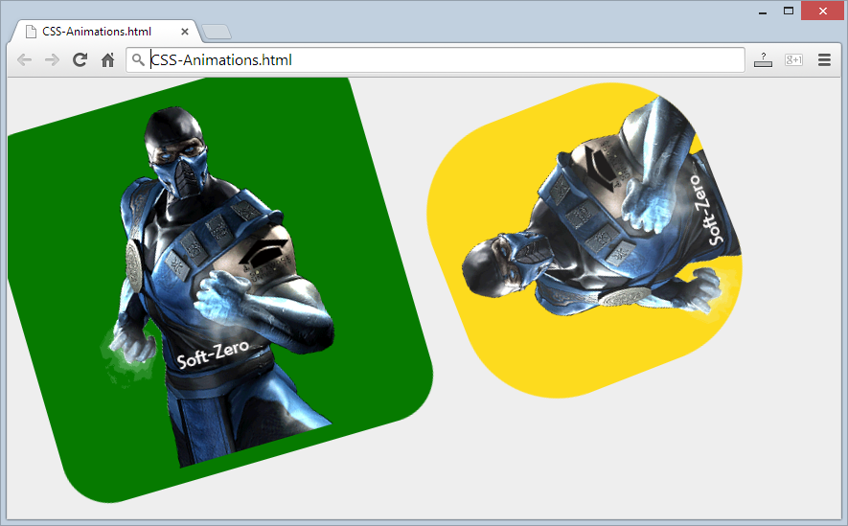
CSS @keyframe Animations
Live Demo

Slide 12
CSS Transitions and Animations
https://softuni.bg/courses/web-fundamentals/

Slide 13
License
This course (slides, examples, demos, videos, homework, etc.) is licensed under the "Creative Commons Attribution-NonCommercial-ShareAlike 4.0 International" license
Attribution: this work may contain portions from
"HTML Basics" course by Telerik Academy under CC-BY-NC-SA license
"CSS Styling" course by Telerik Academy under CC-BY-NC-SA license

Slide 14







SoftUni Diamond Partners

Slide 15




Free Trainings @ Software University
Software University Foundation – softuni.org
Software University – High-Quality Education, Profession and Job for Software Developers
softuni.bg
Software University @ Facebook
facebook.com/SoftwareUniversity
Software University @ YouTube
youtube.com/SoftwareUniversity
Software University Forums – forum.softuni.bg

